Slide 1
INVESTMENT CASE STUDY
SUBMISSION
By
Akhil Kuragayala

Slide 2
Abstract
Sparks fund, an asset management company, wants to make investments in few companies by understanding the global trends in investments. An effective analysis based on country, sector and investment type can help it make a smart choice.
Business Understanding
Strategy | Investing where most other investors are investing
Source of data | Investment data from crunchbase.com
Goals of data analysis | To support Spark Funds understand the Global trends in investments between 5 to 15 Million. To identify the best sectors, countries and a suitable investment type. To identify the investments in English Speaking countries. Identify best Investment type like venture, seed, private equity etc. suitable for investment. Provide best sector investment potential under top 3 countries
Business Constraints | Permissible investment amount is from 5 to 15 millions and the company wants to invest only in English speaking countries.

Slide 3
Problem solving methodology
Investment data was collected from Crunchbase.com
Raw data was Imported into R
Data Collection
Data Cleaning
Necessary data manipulations were incorporated
Funding Type Analysis – A suitable funding type based on market trends was highlighted
Data Analysis
Country Wise Analysis – Top 3 English speaking countries based on investment amount were determined
Sector wise Analysis – In depth analysis of promising sectors
Data Visualizati on
Final results were moved to Tableau for effective visualization

Slide 4
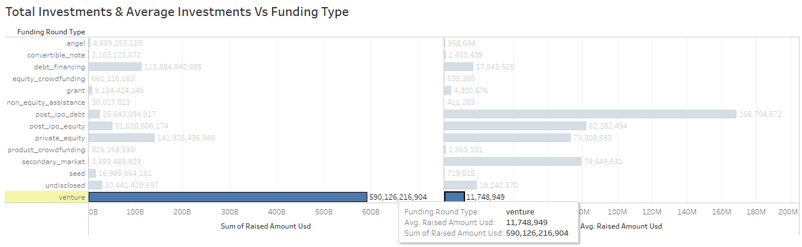
Funding Type Analysis
Number of companies under study | 66368
Preferred Funding types (USD 5M – 15 M) | Out of (Venture, Seed, Private Equity) –Venture is the best suitable for Spark Funds

Slide 5
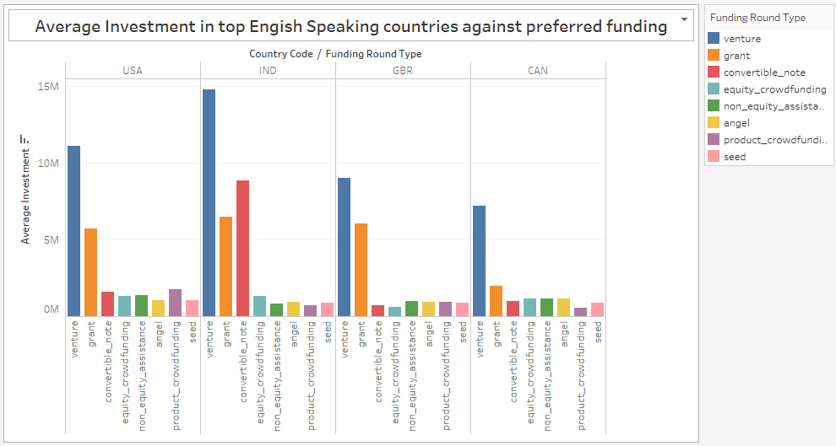
Country Wise Analysis
Top 9 countries based on Average Investment Amounts | USA, CHN, GBR, IND, CAN, FRA, ISR, DEU and JPN
Top 4 English Speaking Countries | USA, IND, GBR, CAN

Slide 6
Sector Wise Analysis(Top 3 sectors)
Country - USA
Sector Name | Number of investments
Others | 2923
Cleantech...Semiconductors | 2297
Social..Finance..Analytics..Advertising | 1912
Country - GBR
Others | 143
Cleantech...Semiconductors | 127
Social..Finance..Analytics..Advertising | 98
Country - IND
Others | 109
News..Search.and.Messaging | 52
Entertainment | 33

Slide 7
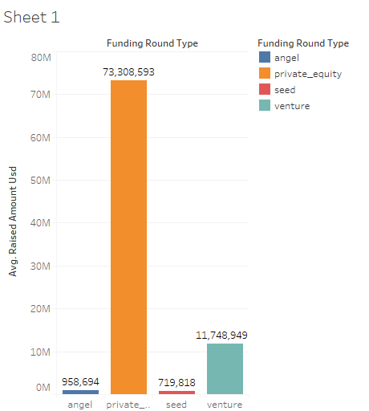
Plot 1 –Funding Type Analysis

Slide 8
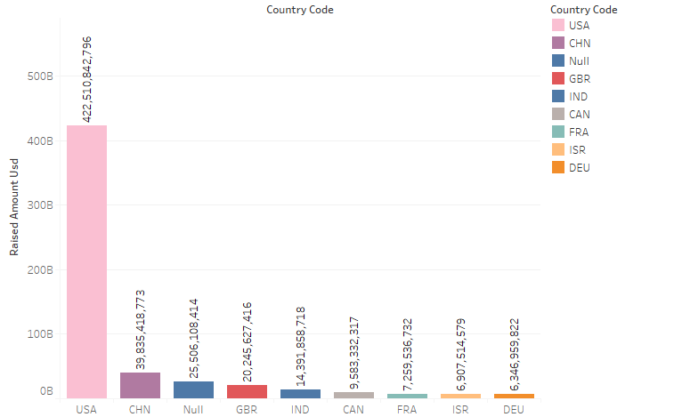
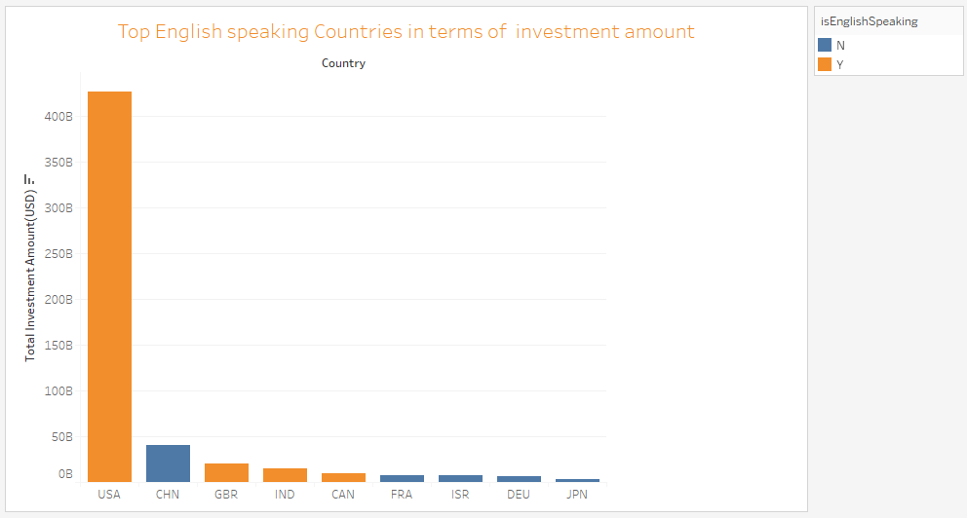
Plot2 - Country Wise Analysis

Slide 9
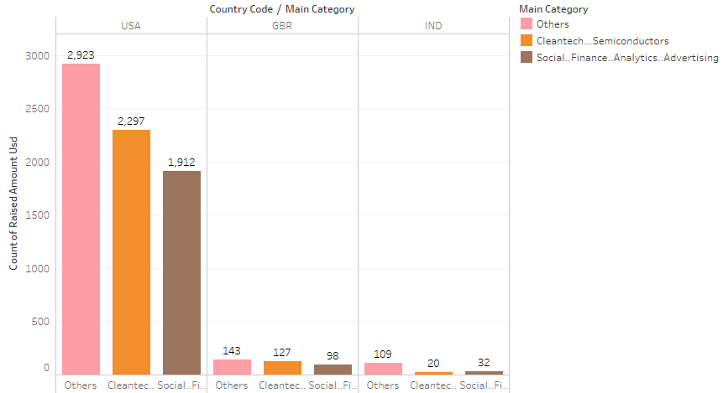
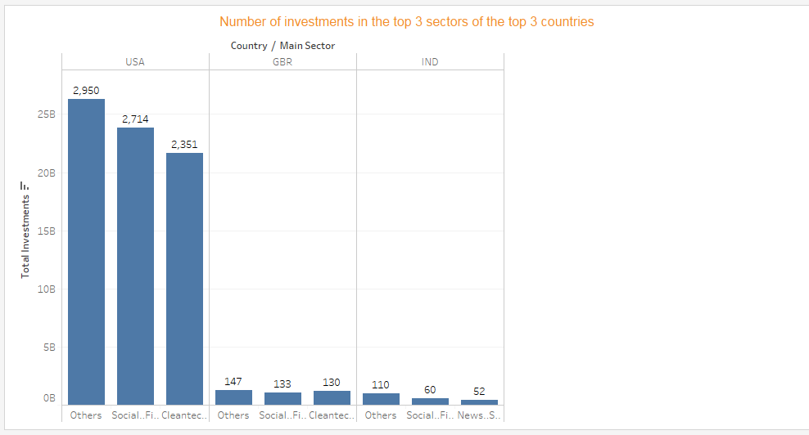
Plot3 - Sector Wise Analysis

Slide 10
Final Analysis
Suitable Investment Type (USD 5M - 15 M) | Venture Type
Top 3 Countries for Investment | USA, GBR, India
Top Sectors to invest | Others | Social, Finance, Analytics, Advertising | Cleantech / Semiconductors | News, Search and Messaging

